Slide 1
Unit 3 Resistance & Ohm’s Law
Part D: Ohm’s Law
Notes:
Hi! Welcome to Unit 1: Quantities and Units, Part A on Electrical Units.

Slide 2
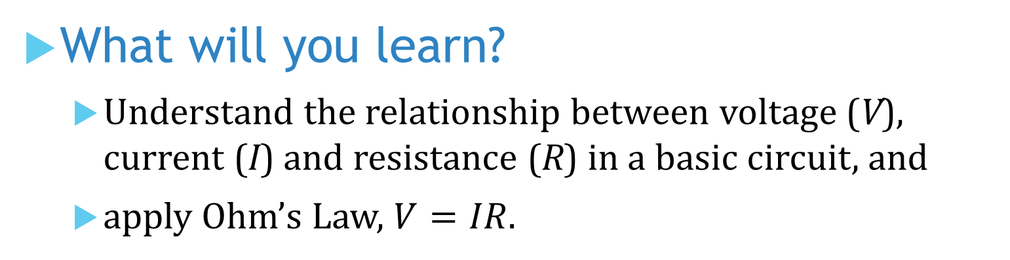
What will you learn?
Understand the relationship between voltage (V), current (I) and resistance (R) in a basic circuit, and
apply Ohm’s Law, $V=IR$.
Notes:
The objective of this unit is to get familiar with and to explain commonly used electrical quantities and their units.

Slide 3
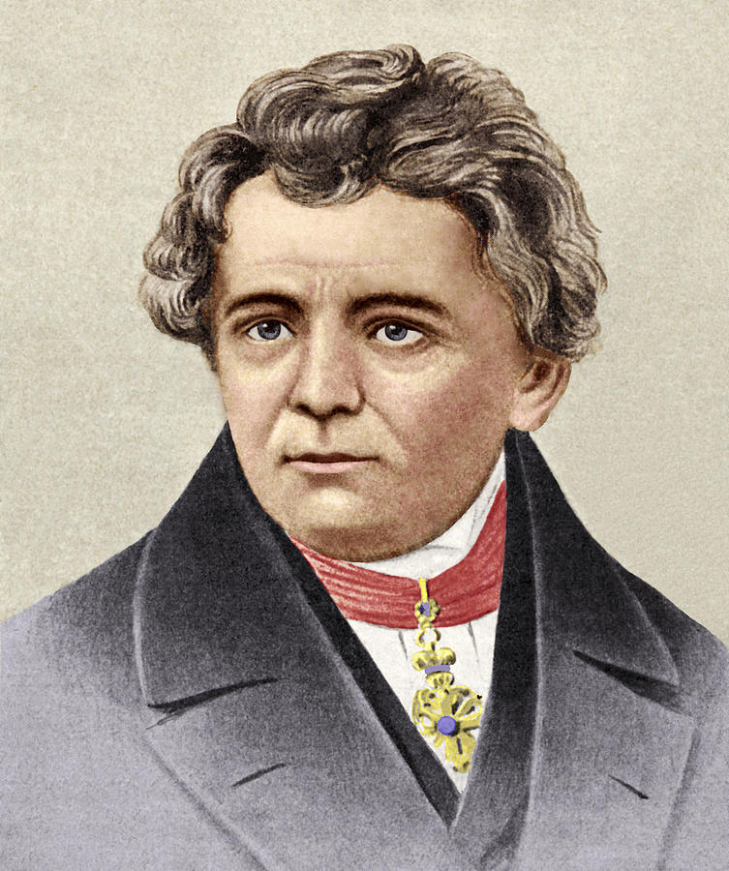

Relationship between voltage and current
German physicist and mathematician Georg Simon Ohm set up an experimental circuit by connecting a conducting material of specific length and cross-sectional area (therefore a specific resistance R) to a voltage source (V).
He applied different voltages to the material and measured the different current (I) flowing through the circuit.
His experiment indicated that the voltage across a resistor is proportional to the current flowing through the resistor.
+
A
−
I
+
V
V
R
−
Notes:
There is a label to every electric appliance. When you pick up an electric kettle, you may notice its label stating the numbers: 220 V to 240 V, 50 or 60 Hz, 2000 – 2400 W.
You wonder what information these numbers are telling us.

Slide 4

Ohm’s Law:
His discovery is stated in the famous Ohm’s law.
The voltage across a resistor is equal to the current in the resistor multiplies the resistance of the resistor.
Voltage (V) is measured in volts (V).
Current (I) is measured in amperes (A).
Resistance (R) is measured in ohms (Ω).
$$V=I R$$
Notes:
Getting curious, you see the power adaptor connecting to your laptop also has a label displaying these numbers: Input of 100 – 240 V; 1.3 A; 50 or 60 Hz; output of 20 V and 2.25 A. It set you thinking again.

Slide 5

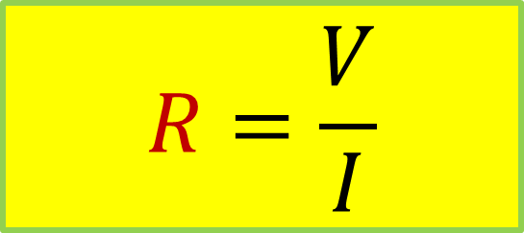
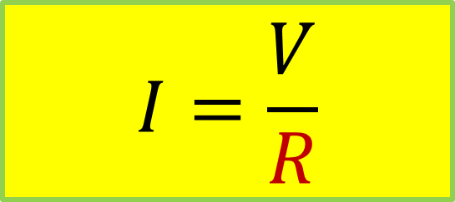
Ohm’s Law
The formula can be displayed in pictorial form
Two alternative formula expressions can be arrived as
$$V=IR$$
$$I=\frac{V}{R}$$
$$R=\frac{V}{I}$$
V
I
R
Notes:
Getting curious, you see the power adaptor connecting to your laptop also has a label displaying these numbers: Input of 100 – 240 V; 1.3 A; 50 or 60 Hz; output of 20 V and 2.25 A. It set you thinking again.

Slide 6
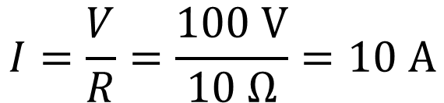
Illustration 1:
Calculate the current I:
+
_
A
+
V
+
I = ?
V
V = 100 V
R = 10 Ω
_
_
I
R
Apply Ohm’s Law to the circuit.
$$I=\frac{V}{R}=\frac{100 V}{10 Ω}=10 A$$
Notes:
You have a camera sitting beside you. Its screen view indicates a low battery. You retract it and notice a label on it reads: 3.7 V, 1000 mAh; Minimum 940 mAh or 3.5 Wh.
Another big question for you.

Slide 7

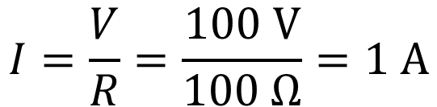
Illustration 2:
Now let R = 100 Ω, calculate the new current I:
+
_
A
+
V
+
I = ?
R = 100 Ω
V
V = 100 V
_
I
R
_
Apply Ohm’s Law to the circuit
$$I=\frac{V}{R}=\frac{100 V}{100 Ω}=1 A$$
For a constant voltage, increase in R resulted in I reduction.
Notes:
You have a camera sitting beside you. Its screen view indicates a low battery. You retract it and notice a label on it reads: 3.7 V, 1000 mAh; Minimum 940 mAh or 3.5 Wh.
Another big question for you.

Slide 8
Illustration 3:
Calculate the voltage needed to produce a 5 A current?
+
_
A
+
V
+
I = 5 A
V
V = ?
R = 100 Ω
_
_
I
R
Apply Ohm’s Law to the circuit
$$V=IR=(5 A)×(100 Ω)=500 V$$
Notes:
You have a camera sitting beside you. Its screen view indicates a low battery. You retract it and notice a label on it reads: 3.7 V, 1000 mAh; Minimum 940 mAh or 3.5 Wh.
Another big question for you.

Slide 9
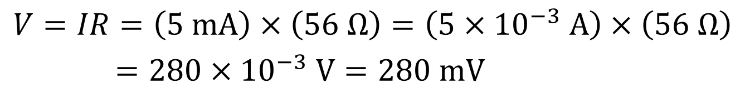
Illustration 4:
What will be the measured voltage across the resistor?
+
_
A
V
+
I = 5 mA
+
V
V = ?
R = 56 Ω
I
R
_
_
Apply Ohm’s Law to the circuit
$$V=IR=\left(5 mA\right)×\left(56 Ω\right)=\left(5×{10}^{−3} A\right)×\left(56 Ω\right)$$
$$=280×{10}^{−3} V=280 mV$$
Notes:
You have a camera sitting beside you. Its screen view indicates a low battery. You retract it and notice a label on it reads: 3.7 V, 1000 mAh; Minimum 940 mAh or 3.5 Wh.
Another big question for you.

Slide 10
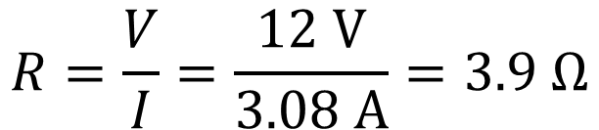
Illustration 5:
Calculate the resistance needed to limit the current to 3.08 A from the 12 V battery.
+
_
A
+
V
+
I = 3.08 A
V
V = 12 V
R = ?
_
_
I
R
Apply Ohm’s Law to the circuit
$$R=\frac{V}{I}=\frac{12 V}{3.08 A}=3.9 Ω$$
Notes:
You have a camera sitting beside you. Its screen view indicates a low battery. You retract it and notice a label on it reads: 3.7 V, 1000 mAh; Minimum 940 mAh or 3.5 Wh.
Another big question for you.

Slide 11
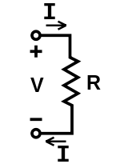
Linear I-V relationship
In an experiment, different voltage V was applied across a 10 Ω resistor. The corresponding current I was measured and recorded.
V (V) | I (A)
10 | 1
20 | 2
30 | 3
40 | 4
50 | 5
60 | 6
70 | 7
80 | 8
90 | 9
100 | 10
Notes:
Eager to find out what they all represent? In fact, you have just seen some of the common electrical terms listed here. That is, electrical quantities and units.
Each quantity and unit can be represented by their respective symbols.
Voltage has a symbol V, and its unit volt by V.

Slide 12
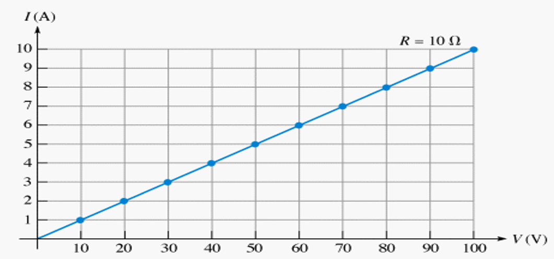
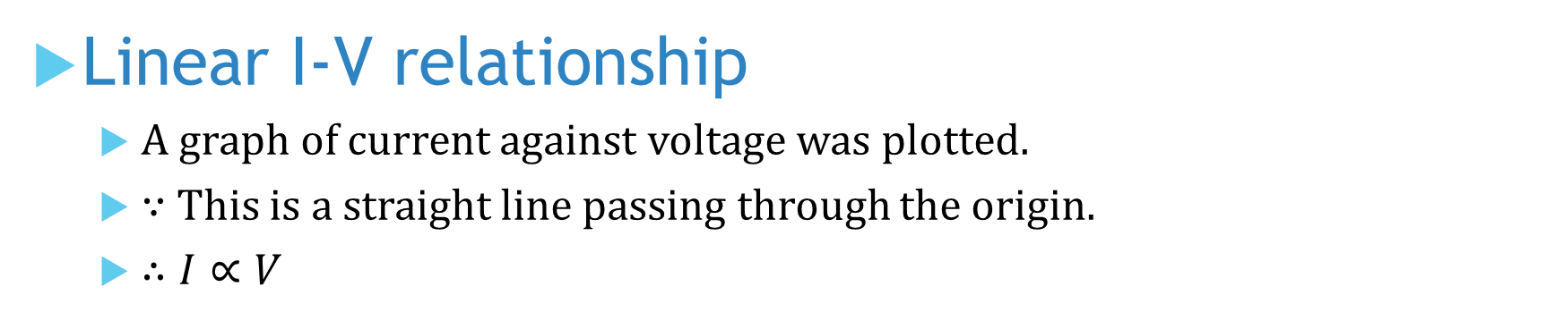
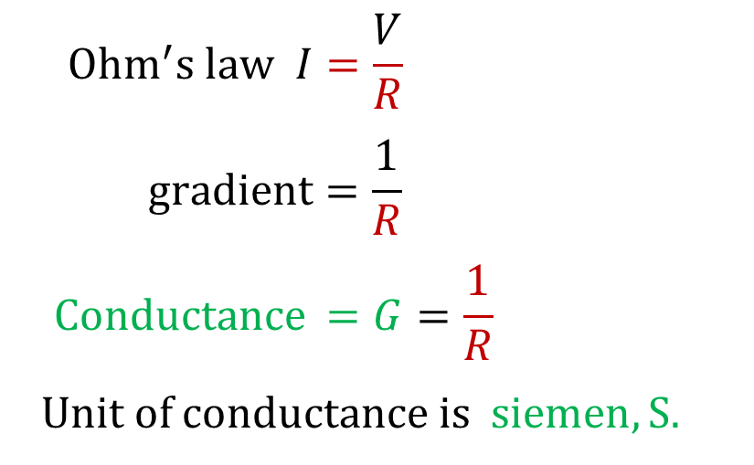
Linear I-V relationship
A graph of current against voltage was plotted.
∵ This is a straight line passing through the origin.
$∴I∝V$
$${Ohm}^{′}s law I=\frac{V}{R}$$
$$gradient=\frac{1}{R}$$
$$Conductance =G=\frac{1}{R}$$
Unit of conductance is$siemen, S.$
Notes:
Eager to find out what they all represent? In fact, you have just seen some of the common electrical terms listed here. That is, electrical quantities and units.
Each quantity and unit can be represented by their respective symbols.
Voltage has a symbol V, and its unit volt by V.

Slide 13
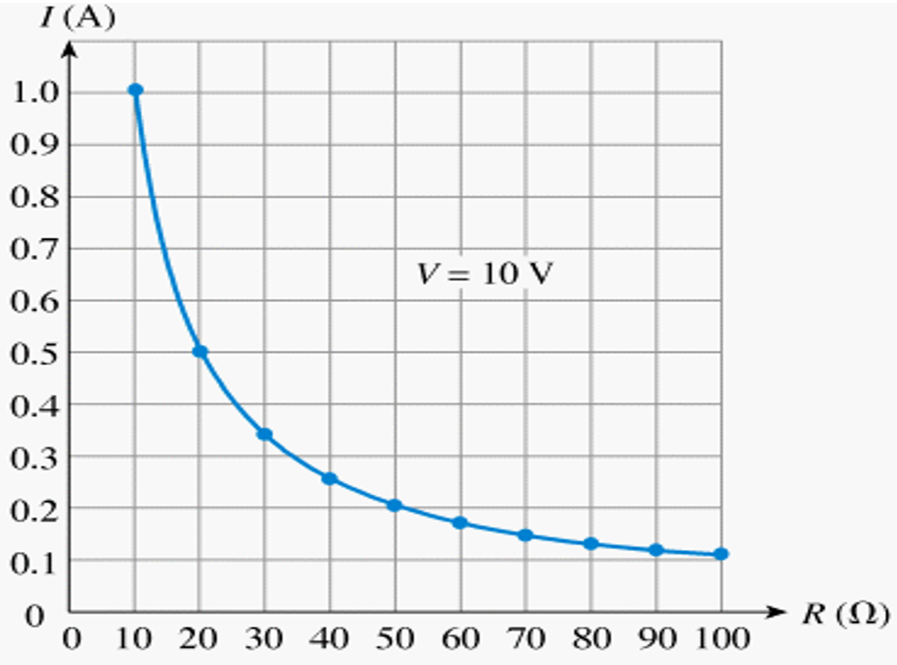

I-R relationship
In the next experiment, the source voltage was kept constant at 10 V. The resistance was adjusted in steps of 10 Ω. The corresponding current was measured and recorded as below.
R (Ω) | I (A)
10 | 1.000
20 | 0.500
30 | 0.333
40 | 0.250
50 | 0.200
60 | 0.167
70 | 0.143
80 | 0.125
90 | 0.111
100 | 0.100
$$∵ I=\frac{V}{R}$$
$$∴ I∝\frac{1}{R}$$
The graph shows that current is inversely proportional to resistance
Notes:
Eager to find out what they all represent? In fact, you have just seen some of the common electrical terms listed here. That is, electrical quantities and units.
Each quantity and unit can be represented by their respective symbols.
Voltage has a symbol V, and its unit volt by V.

Slide 14
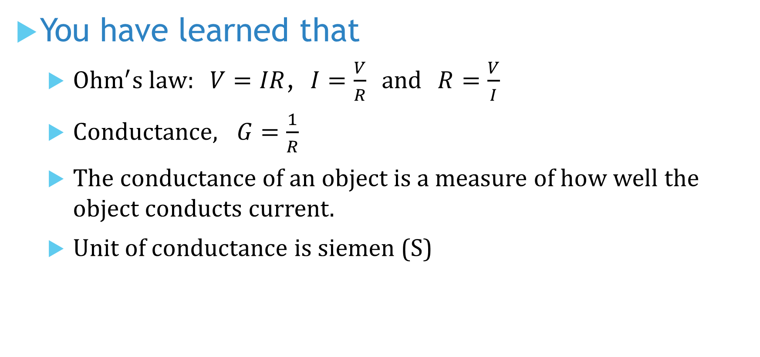
You have learned that
${Ohm}^{′}s law: V=IR$, $I=\frac{V}{R}$ and $R=\frac{V}{I}$
$Conductance, G=\frac{1}{R}$
The conductance of an object is a measure of how well the object conducts current.
Unit of conductance is siemen (S)

Slide 15
Coming Up Next
Energy and Power

